Slide 1
Energy efficiency Scenario
observatoire français des conjonctures économiques
centre de recherche en économie de Sciences Po
www.ofce.sciences-po.fr
Département analyse et prévision
mars 2019

Slide 2
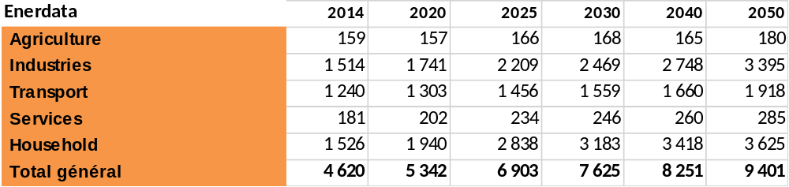

Baseline scenario
«Main » electric mix from Balmorel model
Carbon tax: 95 Mexican pesos
IEA Energy price
GDP Trajectory: medium scenario SENER
Energy consumption target from CONUEE-ENERDATA:
    7625 PJ in 2030 et 9401 PJ in 2050 (not include biomass)
    Annual average growth rate of 1,6% between 2020 et 2050
Rappel titre du diaporama

Slide 3
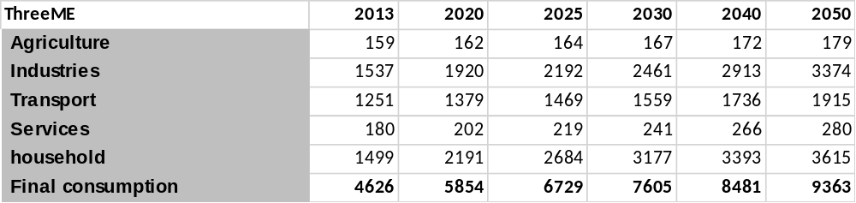
Baseline scenario
Final energy consumption by sector
Source : ThreeME
Rappel titre du diaporama

Slide 4
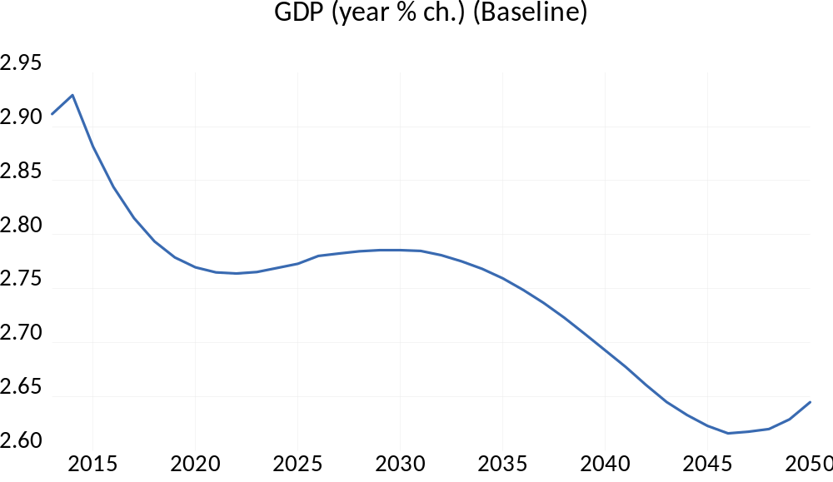
Scénario Baseline
PIB
Source : ThreeME
Rappel titre du diaporama

Slide 5
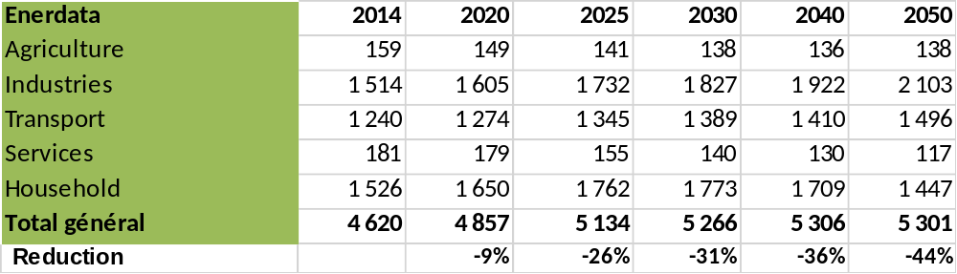
Energy Efficiency scenario
Final energy consumption target CONUEE-ENERDATA:
    5266 PJ in 2030 et 5301 PJ in 2050 (reduction of 44% compared to Baseline)
    Annual average growth rate of 0,3% between 2020 et 2050
    Oil final consumption decrease of 48% in 2050
    Gas final consumption decrease of 19% in 2050
    Electricity final consumption decrease of 45% in 2050
Rappel titre du diaporama

Slide 6
Energy Efficiency scenario
Same electric mix as in the Baseline scenario
Instrument used to get the targets :
  Carbon tax for oil:
    Household ➔ 95 in 2014 to 6000 Mexican pesos in 2050
    Sector ➔ 95 in 2014 to 1500 Mexican pesos in 2050
  Price signal
  Energy efficiency parameters
Rappel titre du diaporama

Slide 7
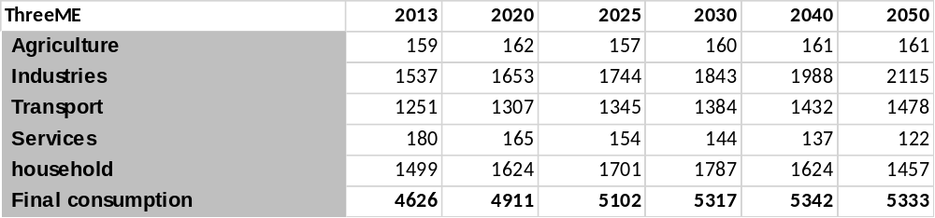
Energy efficiency scenario
Final energy consumption by sector
Source : ThreeME
Rappel titre du diaporama

Slide 8
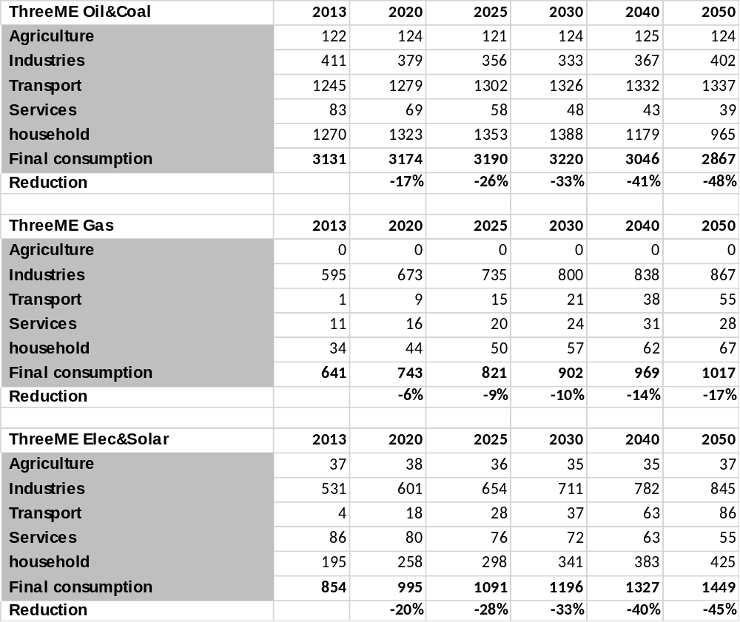
Energy efficiency scenario

Slide 9
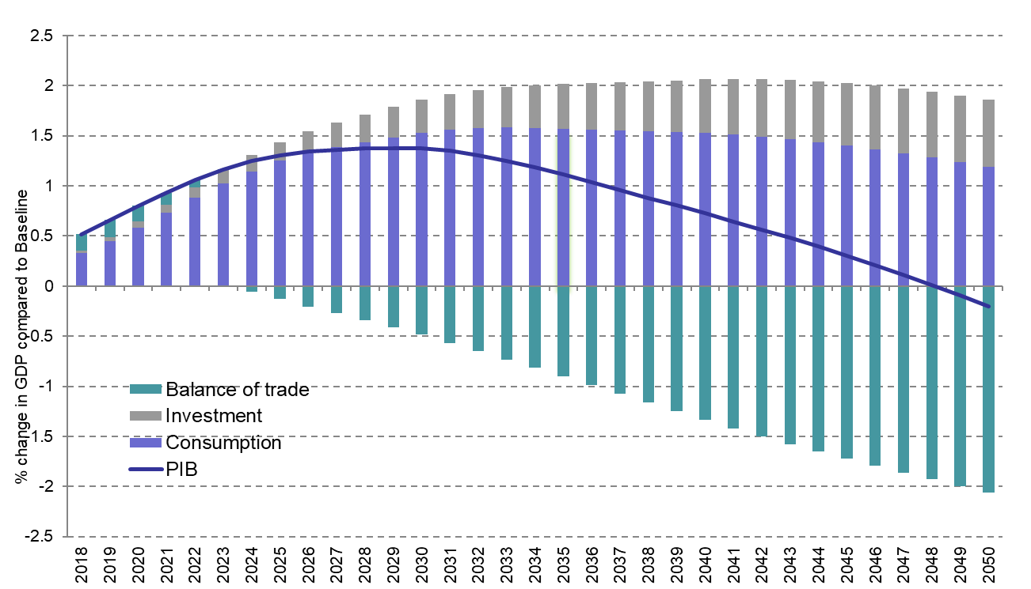
Macroeconomic results
GDP by component
Source : ThreeME

Slide 10
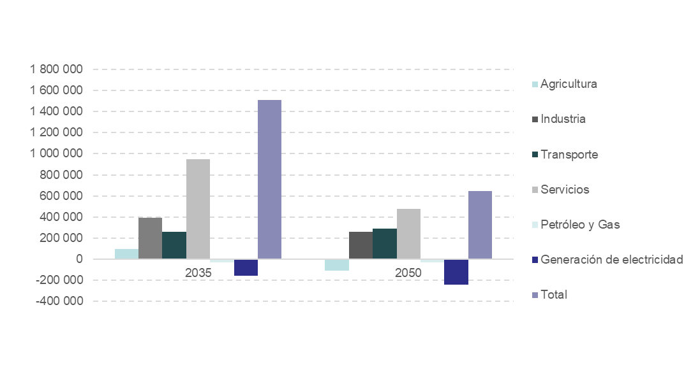
Results by sector
Employment by sector
Source : ThreeME
Increase of 2,1% compared to baseline in 2035 and 0,8% in 2050
Rappel titre du diaporama

Slide 11
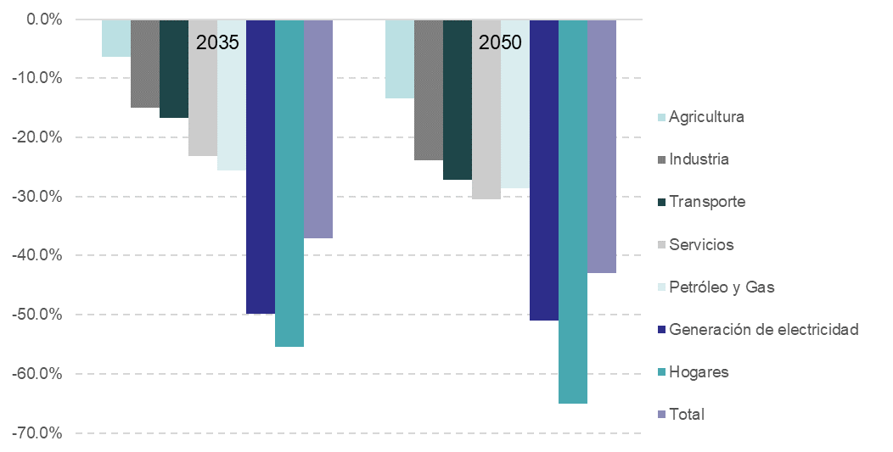
Results by sector
Emission of CO2 for energy consumption by sector
Source : ThreeME
Reduction of 43% compared to baseline
Rappel titre du diaporama

